Slide 1
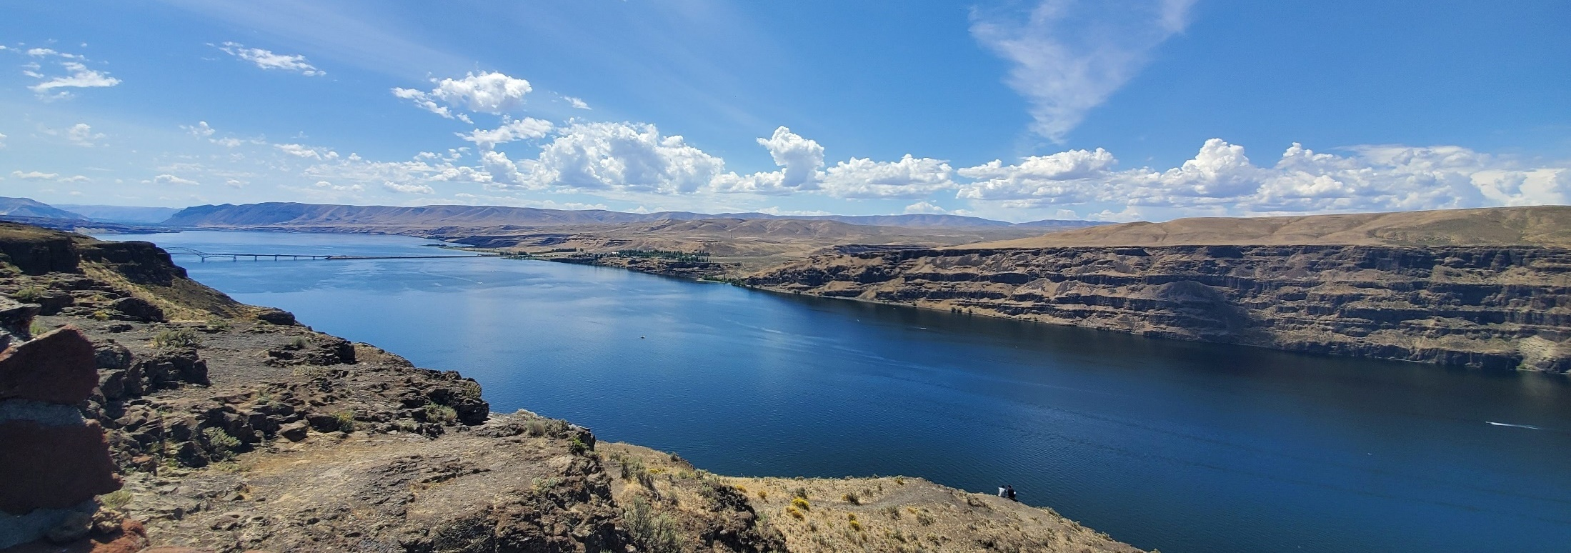
Department of Ecology
MVCC Workshop Presentation
May 21, 2025

Slide 2
Table of Contents
1
Shorelines
2
Critical Areas
3
Water Quality
4
ERTS

Slide 3

Waters of the State
RCW 90.48.020
Wherever the words "waters of the state" shall be used in this chapter, they shall be construed to include lakes, rivers, ponds, streams, inland waters, underground waters, salt waters and all other surface waters and watercourses within the jurisdiction of the state of Washington.
In plain English:
Almost all water on your property is considered a “water of the State”.

Slide 4

Shorelines
The Shoreline Management Act

Slide 5
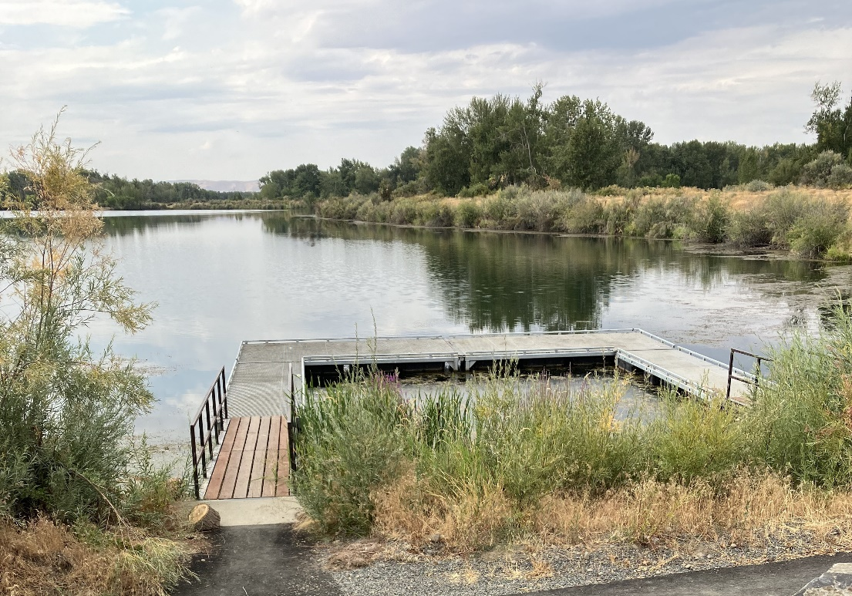
The Shoreline Management Act (1971)
Shorelines of the state are valuable AND fragile
There are a lot of pressures that need coordination
Protect public interest while respecting private property

Slide 6
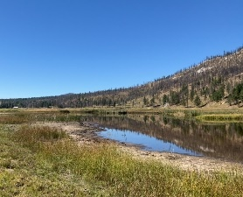
The Shoreline Management Act (1971)
The SMA establishes preferred uses
Single-family residences
Ports
Shoreline recreational uses
Water-dependent industrial/commercial developments
Other developments providing public access opportunities

Slide 7
Where does the SMA apply?
Shorelines of the State
Streams/rivers with >20 cfs mean annual flow
Lakes/ponds ≥ 20 acres
Shorelands – the upland area 200ft from the edge of these waters
Associated wetlands
Some or all of the 100-year floodplain (Okanogan County Specific)

Slide 8
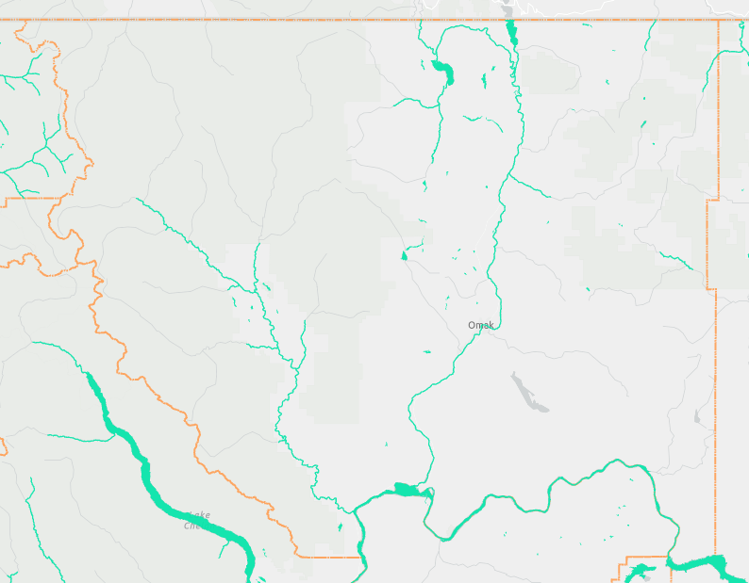
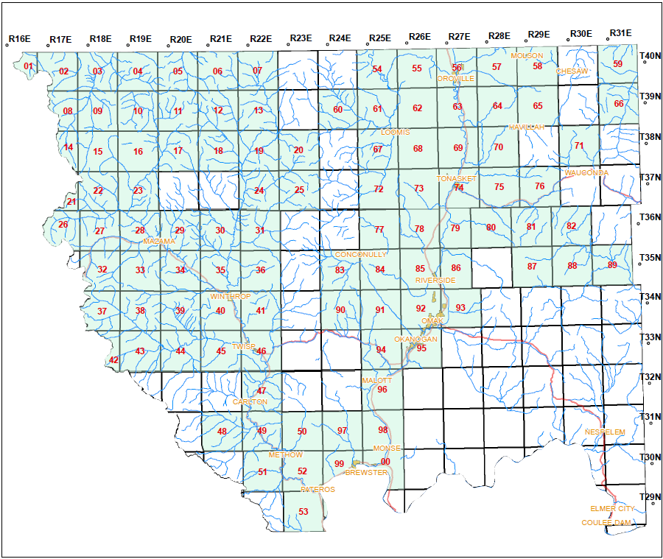
SMA Jurisdiction in Okanogan County

Slide 9
Shoreline Permit Process
SDP
File
Filing Letter
Appeal Period
County approves the Substantial Development Permit
County files the SDP with Ecology
Ecology sends the applicant a letter of filing
Must wait 21 days after filing to begin activities
CUP/VAR
Ecology Review
Decision Letter
Appeal Period
County approves the Conditional Use Permit or the Variance Permit
County sends the CUP/VAR to Ecology, which gets another 30 day review to approve or deny
Ecology sends the applicant a decision letter, separate from the local government
Must wait 21 days after filing to begin activities

Slide 10
Critical Areas
The Shoreline Management Act, Wetlands, the Water Pollution Control Act, the Federal Clean Water Act, and the County Ordinances

Slide 11
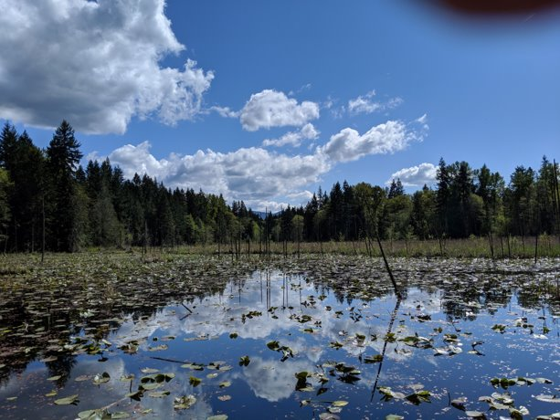
What is a Critical Area?
Wetlands
Frequently Flooded Areas
Fish & Wildlife Habitat Conservation Areas
Aquifer Recharge Areas
Geological Hazard Areas

Slide 12
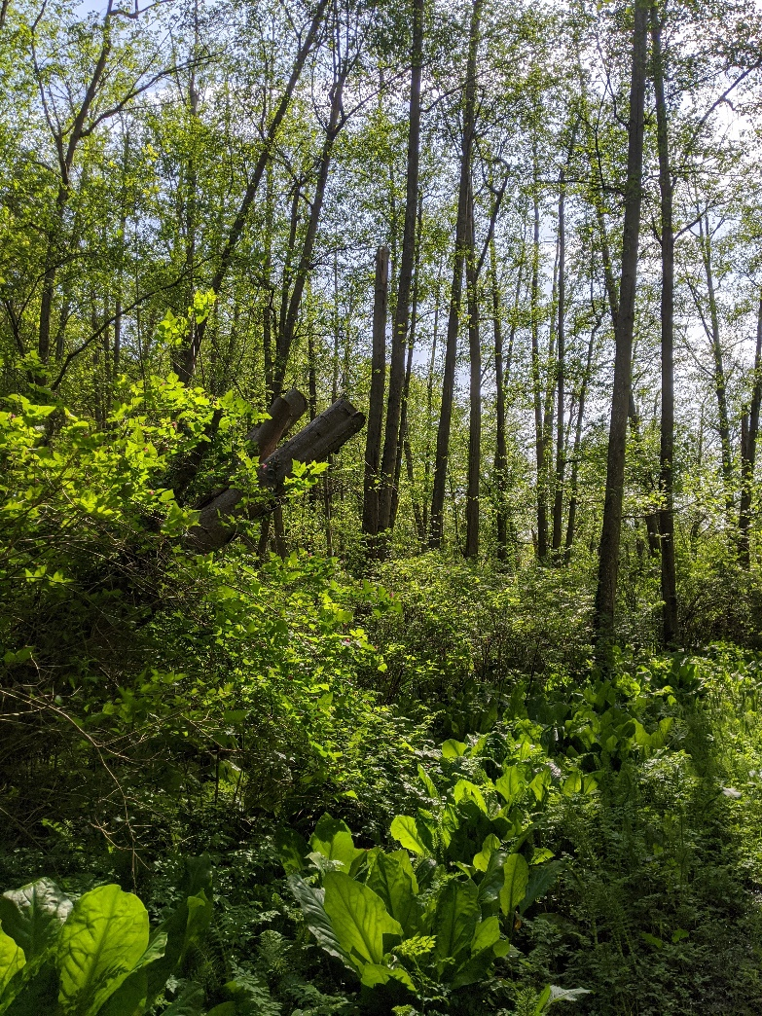
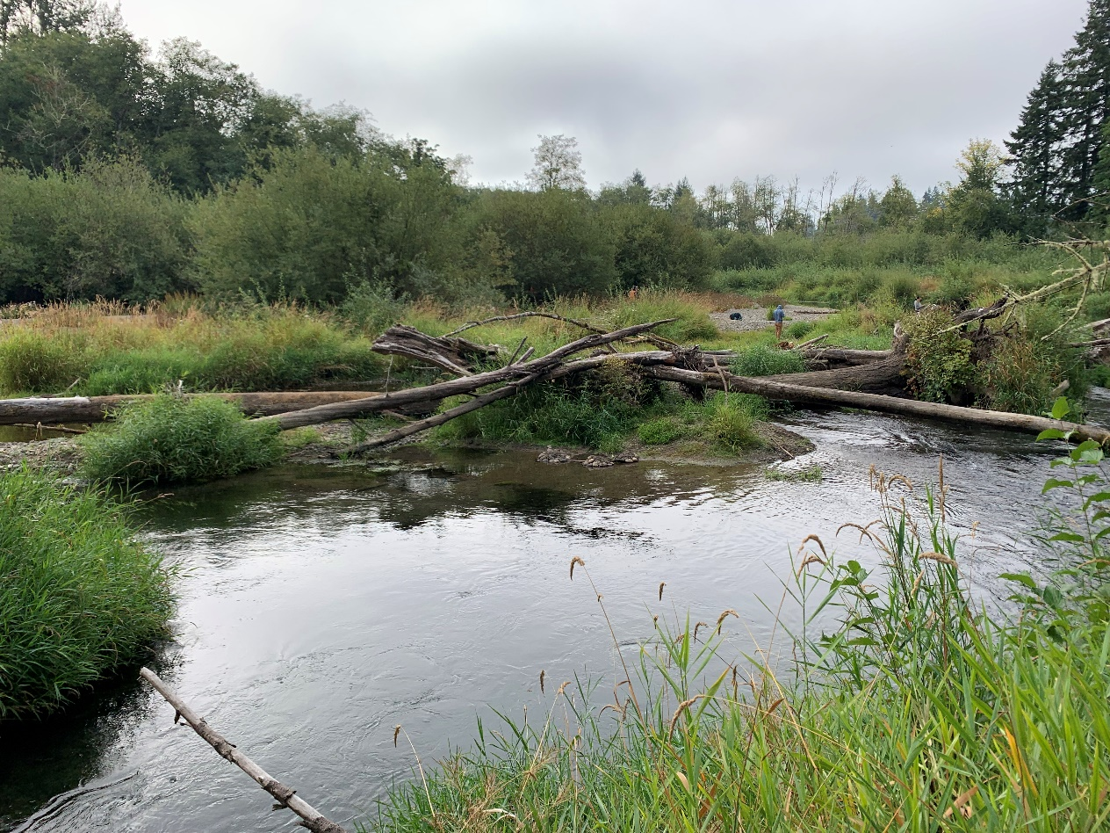
Wetlands

Slide 13
Water Quality
The Water Pollution Control Act

Slide 14
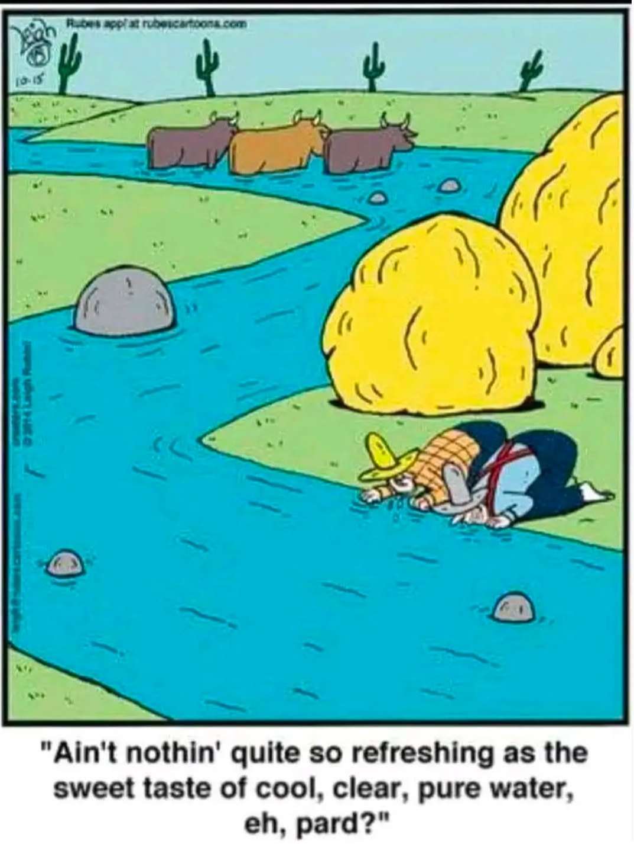
Water Quality
Watershed assessments
Non-point source pollution
Stormwater permits

Slide 15

What is a "waterway?"
It's just a trickle- waterway
There's only water in it part of the year- waterway
It's a roadside "ditch"- could be a waterway!
Irrigation company ditch- waterway as far as discharges go.

Slide 16
What is a pollutant? (RCW 90.48)
Chemicals (any substance other than water)
Trash
Sediment
Heat
Livestock excretions
Please keep all substances other than cold water out of the waterways.

Slide 17
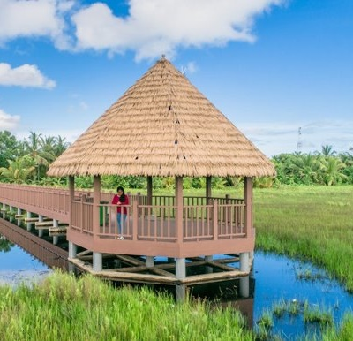
Activities that may require a permit
Excavation of the banks/shorelines.
Activities involving heavy equipment/construction.
Plans to divert or use water. (Water Right)

Slide 18
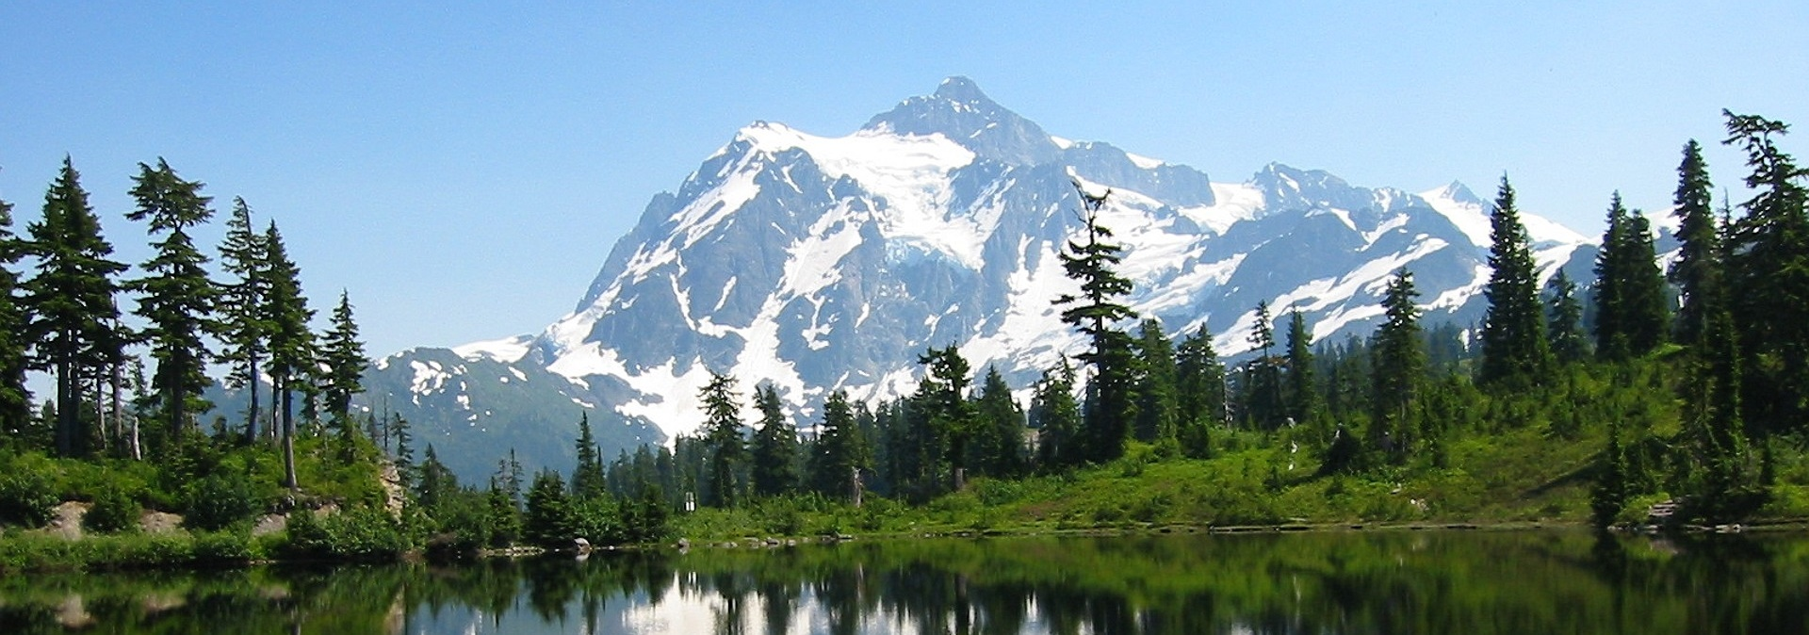
Construction Stormwater General Permit
Covers the discharge of water from construction sites and lines out the requirements to prevent pollution (BMPs).
Notes:
REVISED 11/16/2022 - AJ

Slide 19

When do I need a CSWGP?
When 1 acre or greater will be cleared, excavated, graded or otherwise disturbed, creating possibility of runoff to surface waters.
Projects less than 1 acre that are part of a larger plan to develop/disturb 1 acre or greater.
Projects of any size that reasonably expect to cause a violation of water quality standards.

Slide 20
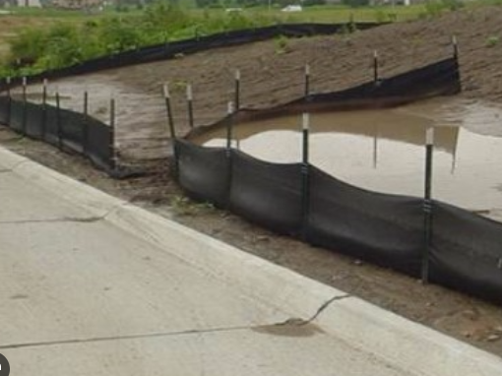
ANY TIME YOU'RE WORKING NEAR WATER
Contact us, better safe than sorry!

Slide 21
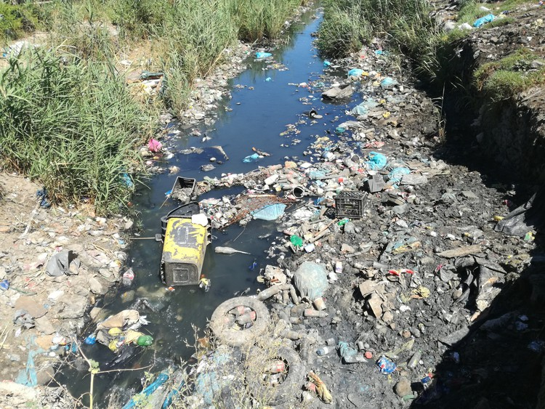
Environmental Report Tracking System (ERTS)
ThePhoto by PhotoAuthor is licensed under CCYYSA.

Slide 22
What's so great about ERTS?
Centralized reporting connecting all interested parties, including:
City & County code enforcement/Planners
US Army Corps of Engineers, EPA
Local Health Districts
All Ecology divisions (air, water, toxics, spills, solid waste, etc.)
Dept of Ag, Fish & Wildlife, and MORE

Slide 23
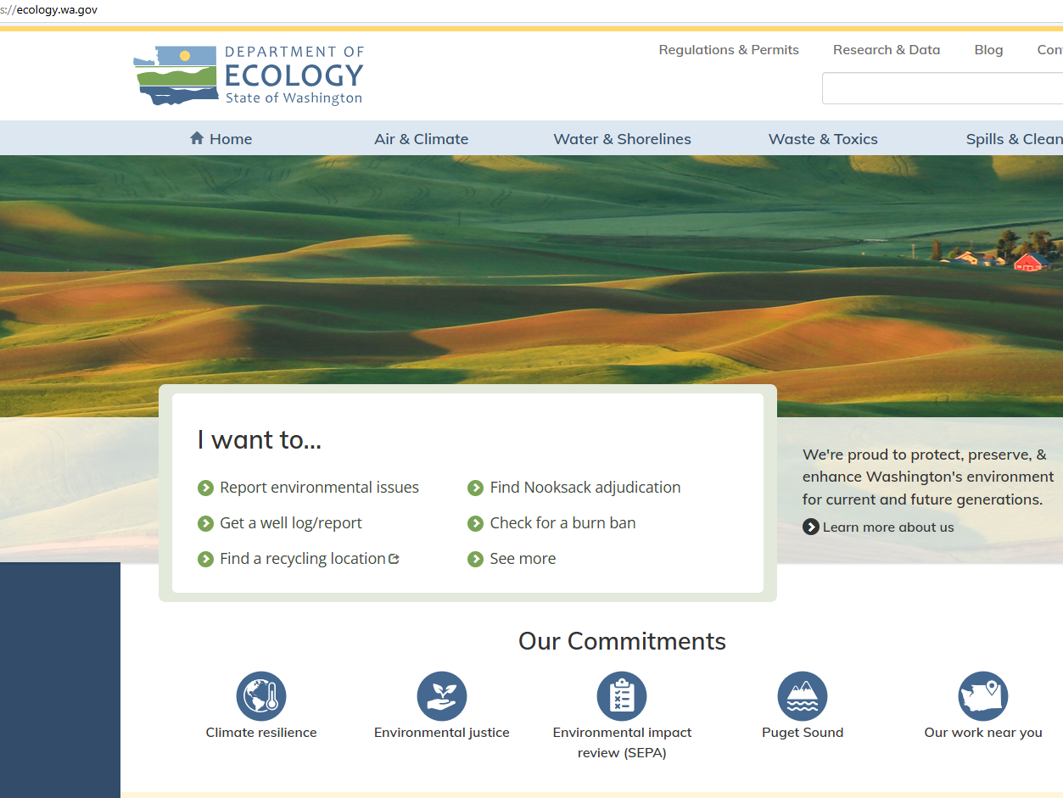
Ecology.wa.gov

Slide 24
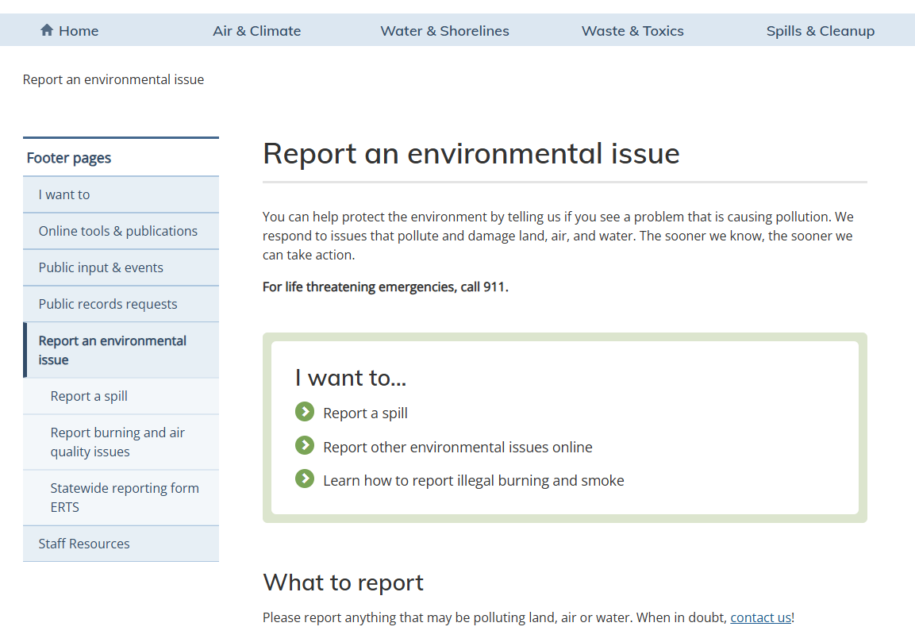

Slide 25
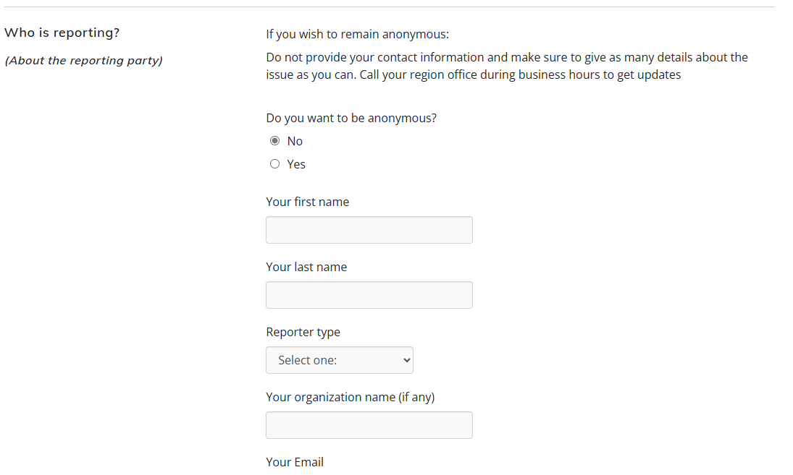

Slide 26

To be, or not to be...Anonymous
Anonymous
Non-anonymous
We don't reveal your name unless they get a Public Records Req.
You can show us the problem firsthand
Answer questions, give additional reports
Some local gov't will NOT follow up on Anon reports
(Less) confrontation for you.
One and DONE

Slide 27
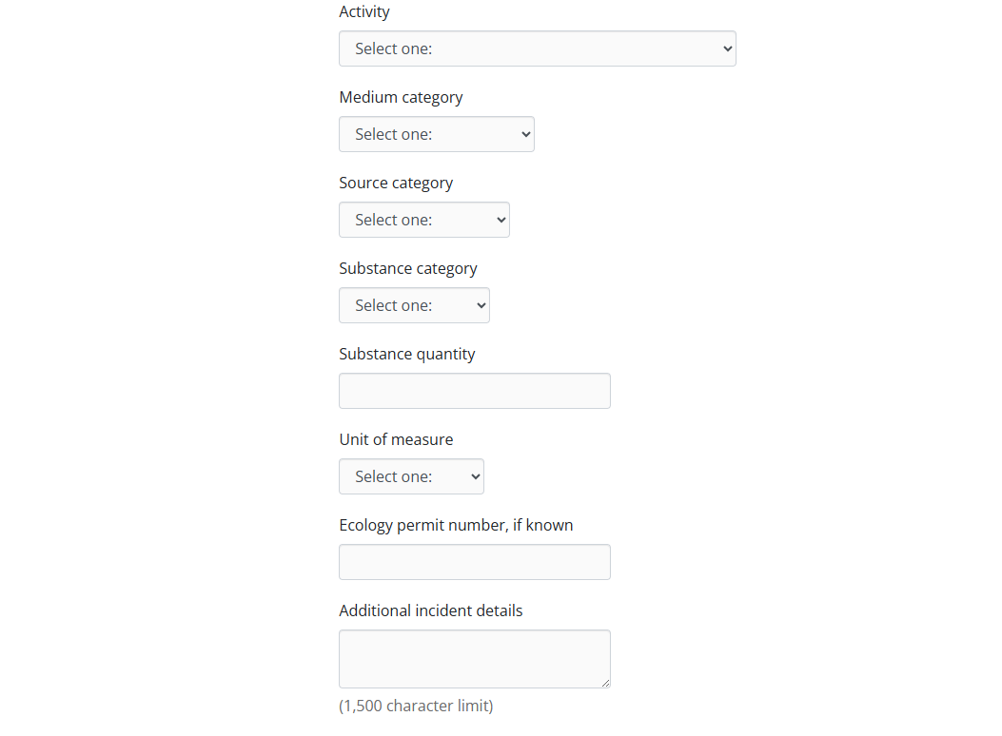
There's room for about 250 words here.
Email and phone calls are better for longer narratives.

Slide 28

For Context
This is what 1500 characters looks like. It is roughly between 240 to 260 words, which should be enough for a short but detailed description. This is what 1500 characters looks like. It is roughly between 240 to 260 words, which should be enough for a short but detailed description. This is what 1500 characters looks like. It is roughly between 240 to 260 words, which should be enough for a short but detailed description. This is what 1500 characters looks like. It is roughly between 240 to 260 words, which should be enough for a short but detailed description. This is what 1500 characters looks like. It is roughly between 240 to 260 words, which should be enough for a short but detailed description. This is what 1500 characters looks like. It is roughly between 240 to 260 words, which should be enough for a short but detailed description. This is what 1500 characters looks like. It is roughly between 240 to 260 words, which should be enough for a short but detailed description. This is what 1500 characters looks like. It is roughly between 240 to 260 words, which should be enough for a short but detailed description. This is what 1500 characters looks like. It is roughly between 240 to 260 words, which should be enough for a short but detailed description. This is what 1500 characters looks like. It is roughly between 240 to 260 words, which should be enough for a short but detailed description. This is what 1500 characters looks like. It is roughly between 240 to 260 words,
Email and phone reports are also a great option.

Slide 29
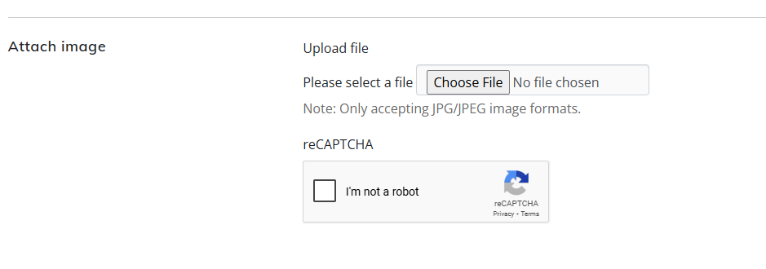

New and improved!
One photo ONLY!
You can email multiples or videos.

Slide 30

Keep in mind
The more details and information we have, the better.
Addresses
Names & Contact information
Photos/videos
History of incidents
We can only respond to non-emergencies as time and agency resources allow.

Slide 31
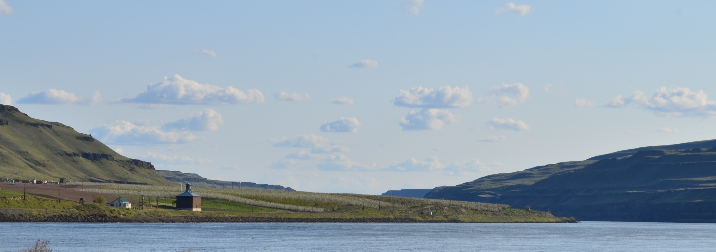
Thank you
Pick up contact info at our table

