Slide 1
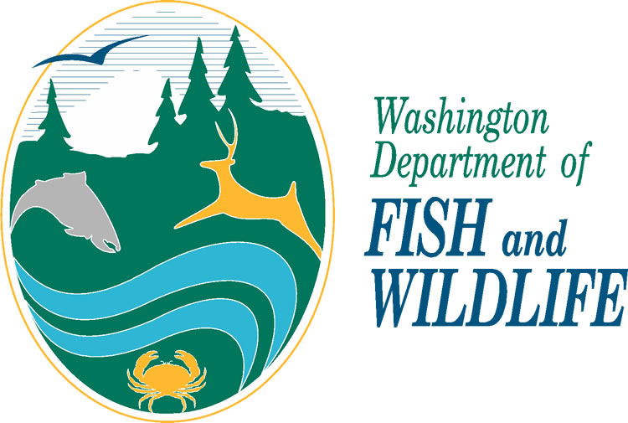
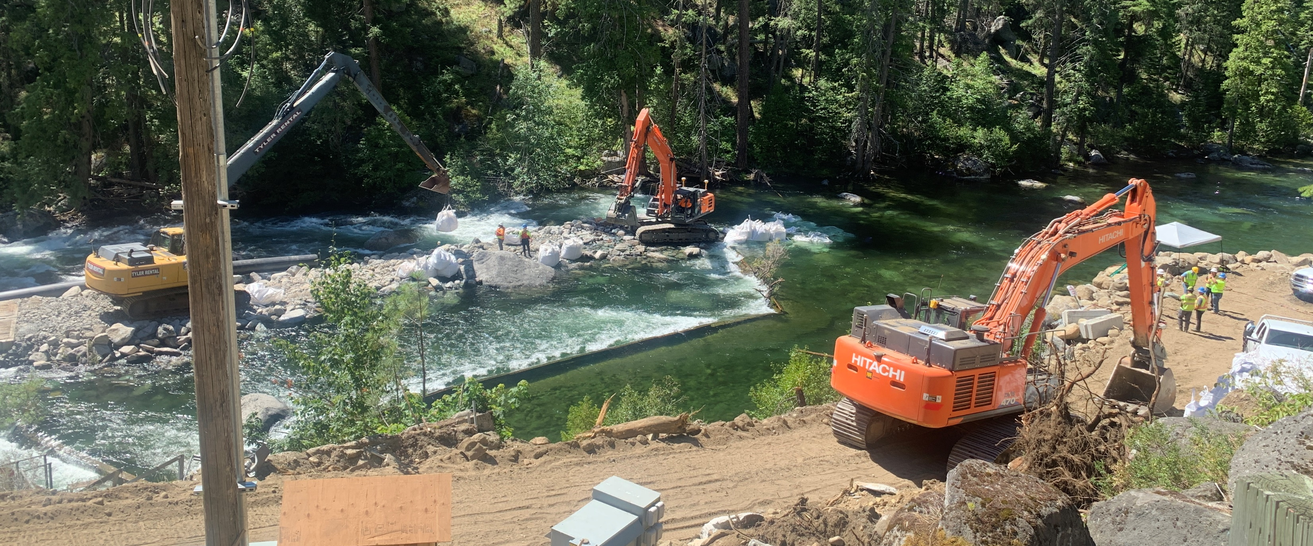

Methow Compliance and Permitting Workshop
May 21, 2025
Photo by Kim Chandler

Slide 2

WDFW Programs
Capital & Asset Management Program
Director’s Office
Enforcement
Fish
Habitat
Wildlife

Slide 3
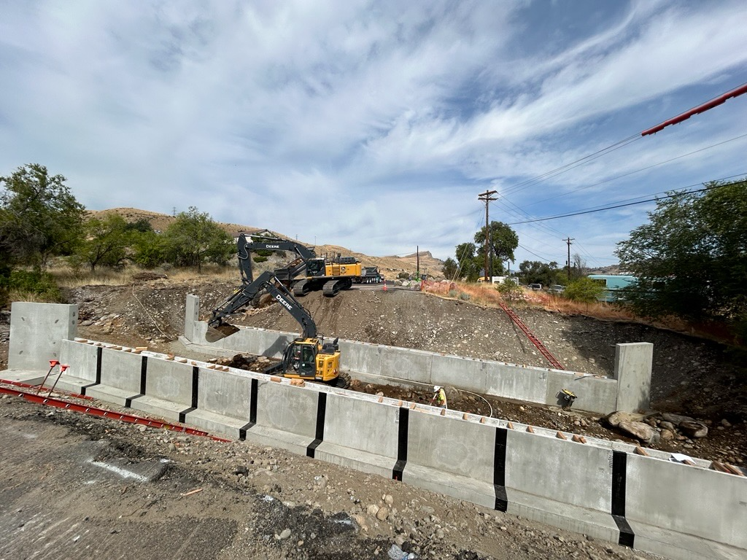
Hydraulic Code
Chapter 77.55 RCW and Chapter 220-660 WAC
RCW 77.55.011(11): A hydraulic project is construction or other work activities conducted in or near state waters that will “use, divert, obstruct, or change the natural flow or bed of any of the salt or fresh waters of the state”.
Notes:
DFW expertise assists project proponents:
Considering natural processes and therefore improving the projects success over time while minimizing damages to public and private infra-structure.
Good project design has been shown to significantly reduce the maintenance and repair costs over the life of the project.
Properly designed structures also minimize impacts to upstream and downstream properties which can assist in avoiding neighbor conflicts or legal disputes.
In some cases we are able to show an applicant a different approach that avoids the need for the HPA altogether
We are the only agency that is “on-the-ground” during emergencies helping people to respond promptly to their needs.

Slide 4
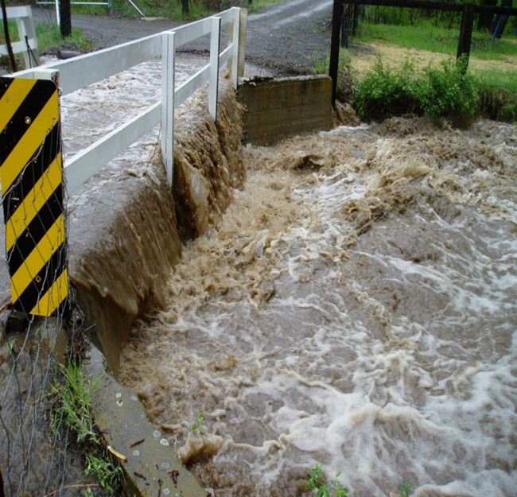
Hydraulic Code Benefits
Chapter 77.55 RCW and Chapter 220-660 WAC
Minimize impacts to private properties and public infrastructure.
Improve project performance.
Provide technical expertise to applicant and other agencies.
Protect natural fish production contributing to fishing opportunities.
Undersized Bridge
Notes:
DFW expertise assists project proponents:
Considering natural processes and therefore improving the projects success over time while minimizing damages to public and private infra-structure.
Good project design has been shown to significantly reduce the maintenance and repair costs over the life of the project.
Properly designed structures also minimize impacts to upstream and downstream properties which can assist in avoiding neighbor conflicts or legal disputes.
In some cases we are able to show an applicant a different approach that avoids the need for the HPA altogether
We are the only agency that is “on-the-ground” during emergencies helping people to respond promptly to their needs.

Slide 5
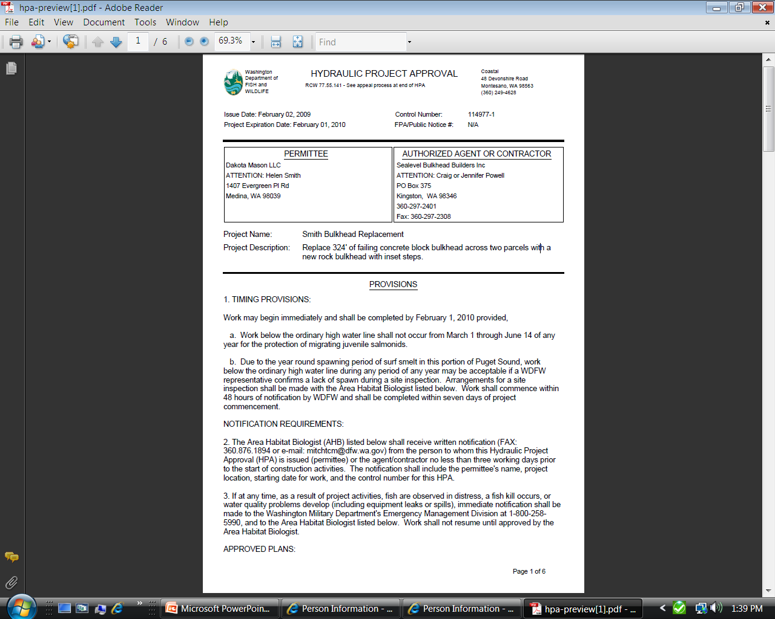

Types of Hydraulic Project Approvals (HPAs)
Chapter 77.55 RCW and Chapter 220-660 WAC
The HPA is the permit WDFW issues to protect fish life and fish habitat.
Types of HPAs include:
  Standard
    Streamlined Processing*: Fish Habitat Enhancement Projects and Habitat Recovery Pilot Program (2021-2025)
  Emergency
  Expedited
  Pamphlet
Notes:
The Hydraulic Project Approval or HPA is the permit the department issues to authorize work in or near water. The HPA has provisions the permittee must follow when constructing their project.
Area habitat biologists processes about 4,000 HPA applications each year.
HPAs are issued, conditioned or denied solely for the protection of fish and their habitat.

Slide 6
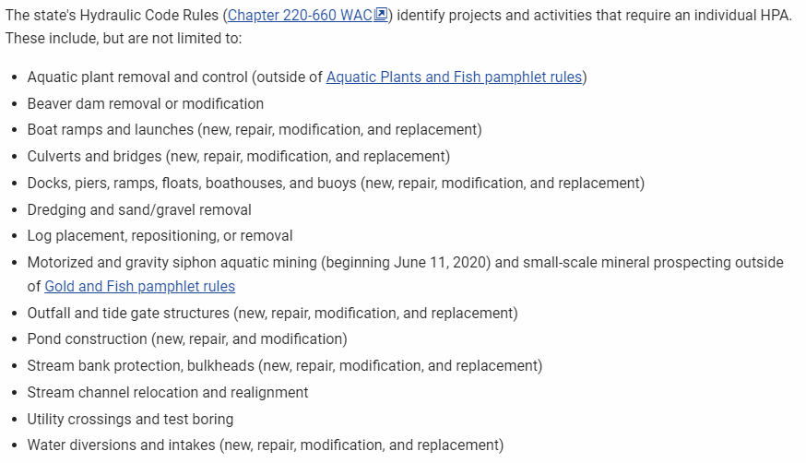
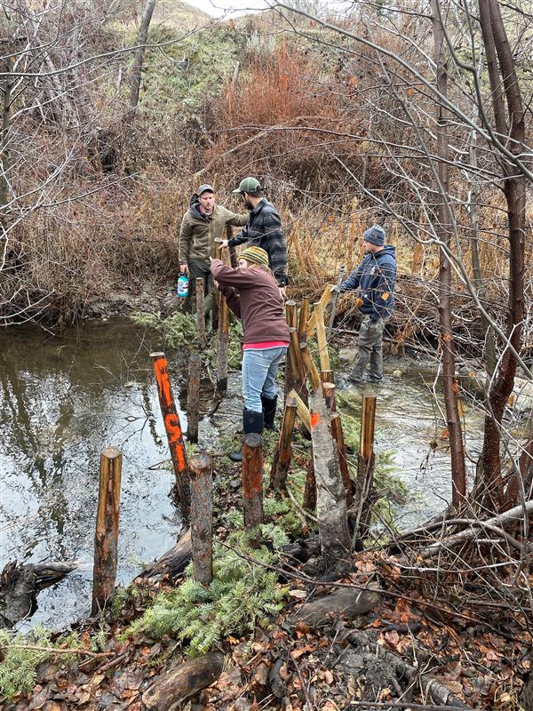
When would I need an HPA?

Slide 7
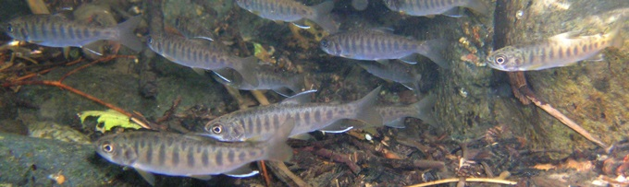
What is needed to apply for a standard HPA?
HPA Application OR a JARPA
SEPA Determination
Project Plans with the OHWL labeled
Notes:
Joint Aquatic Resources Project Application
SEPA Determination: Categorical exemption, DNS, MDNS, DS
Determination of non-significance, mitigated determination of non-significance, or determination of significance

Slide 8
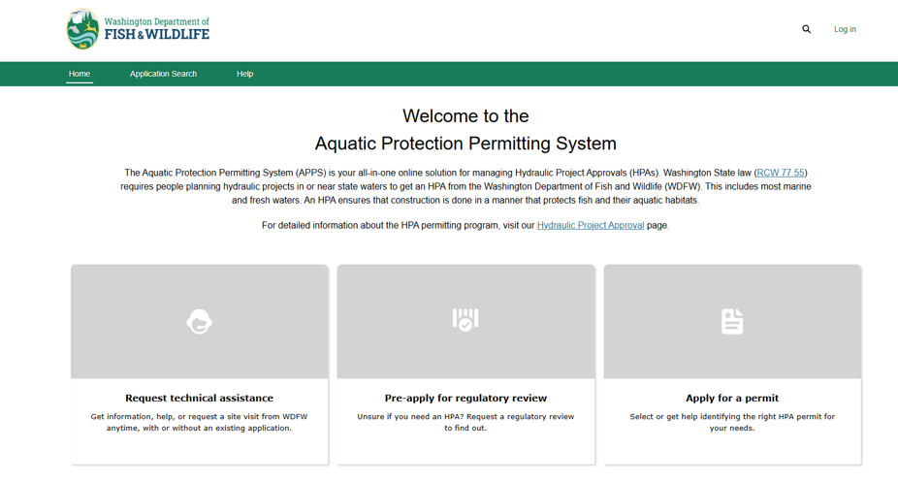

APPS can be used to produce a draft JARPA that includes information submitted in the online APPS application.
  You can then complete the JARPA outside of APPS and submit it to other permitting agencies that require a JARPA form.
Already filled out the JARPA? Submit to APPS processing team.
Aquatic Protection Permitting System (APPS)

Slide 9
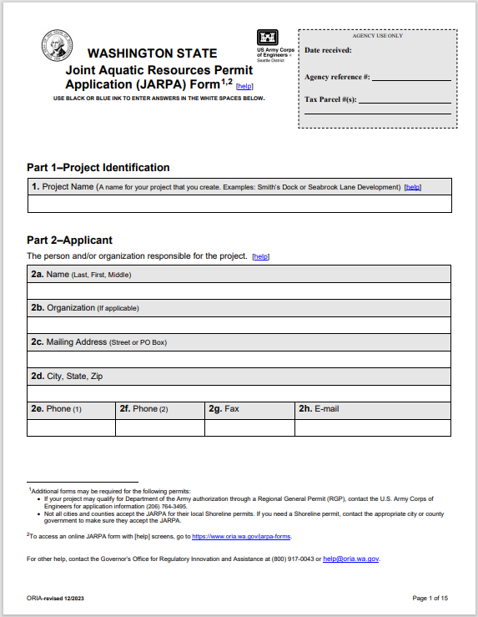

Joint Aquatic Resources Permit Application (JARPA)
Federal
  U.S. Army Corps of Engineers (Corps): Section 10 and Section 404 (Corps Permits FAQ).
  U.S. Coast Guard: Private Aids to Navigation (PATON).
State
  Washington Department of Ecology: 401 Water Quality Certification.
  Washington Department of Fish and Wildlife: Hydraulic Project Approval (HPA FAQ).
  Washington Department of Natural Resources: Aquatic Use Authorization.
Local
  Shoreline Substantial Development Permit.
  Shoreline Conditional Use Permit.
  Shoreline Variance.
  Shoreline Exemption

Slide 10
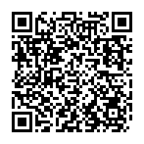
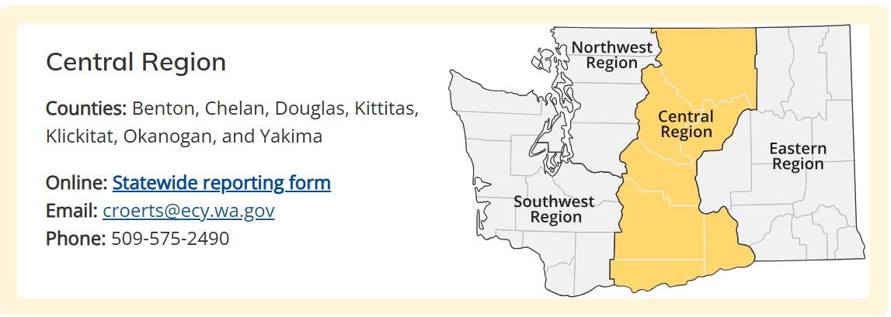
See a Violation?
How to report
Report an environmental issue to the Ecology region office in the county where the problem is located. Use any of the following options:
  Online (in English only)
  By email or phone (see information below)
  In-person at one of our offices
You can report in your preferred language by calling, sending an email, or in person. Translation and interpretation services are available at no cost. If you need an interpreter, please ask for one.
Reports are reviewed during business hours, Monday through Friday, 8 a.m. – 5 p.m. The region’s ERTS Coordinator will enter the information into the database and send it to the appropriate Ecology Program or another agency responsible for responding to the issue.
If you wish to remain anonymous, Do not provide your contact information and make sure to give as many details about the issue as you can. Call your region office during business hours to speak to us if you want to get updates.

Slide 11

Violation Was Reported…. What is WDFW going to do?
1
2
3
4
The region’s ERTS Coordinator will enter the information into the database and send it to the appropriate Ecology Program or another agency responsible for responding to the issue.
Habitat Biologist looks at the report, fish use, and sends information to compliance.
Internal investigation can include site visits, desktop review, and speaking with the landowner and/or reporting party.
WDFW works with the violator and partnering agencies to come into compliance.
Notes:
compliance can show up at any time to look for violations but will usually contact first) or report of an unpermitted project, compliance will do an investigation to determine level of fish harm
**Investigation to see if it falls under the hydraulic code and if it harms fish life or habitat.***

Slide 12
Definitions of Types of Harm
Minor Harm
More Than Minor Harm
Significant Harm
Notes:
“Minor Harm” – A direct or indirect act that creates the likelihood of injury to fish life by disrupting normal behavior patterns, which includes but are is not limited to spawning, rearing and/or migration behaviors or habitats. The act does not result in mortality of fish life or more than short-term degradation of fish habitat
“More than Minor Harm” – A direct or indirect act that results in injury to fish life, mortality of individual fish, or disruption of normal behavior patterns, which includes but is not limited to spawning, rearing and/or migration behaviors or habitats. The act results in more than short-term degradation of fish habitat.
“Significant Harm” – A direct or indirect act that results in the injury or mortality of multiple fishes, which includes but is not limited to fish life or life histories; spawning, rearing, or migration behaviors or habitats; and/or loss of productivity. The act may result in short or long-term degradation of fish habitat.

Slide 13

HPA Compliance – Administrative Enforcement Actions
Corrections Request
Notice to Comply
Stop Work Order
Notice of Penalty
Notice of Intent to Disprove HPA Application
Notes:
A CR is used to request corrective actions necessary to prevent or repair damage causing minor harm to fish life. (most frequently used, informal action)
A NTC is used when a violation has occurred and a SWO is unnecessary but there is still a need for corrective action to prevent or repair damage to and/or compensate for more than minor harm fish life.
SWO are used after the hydraulic project has started and there is a violation is occurring that may cause significant harm to fish life; and immediate action is necessary to prevent continuing or to avoid more than minor harm to fish life.
Civil penalties may be imposed if a person fails to complete the actions recommended in a Correction Request (CR); or required in a Notice to Comply (NTC) or Stop Work Oder (SWO). The department may also issue a civil penalty without first issuing a CR, NTC or SWO if a violator has had a Hydraulic Project Approval (HPA) enforcement action in the past five years; the violation has a probability of causing more than minor harm to fish life; or the violator is conducting or has conducted a hydraulic project without a Hydraulic Project Approval (HPA).
The department can issue a Notice of Intent to Disapprove an HPA application when a civil penalty is overdue or the terms of a NTC or SWO are violated. The disapproval period lasts for up to one year or until the violator comes into compliance, whichever is longer.

Slide 14

Do I need an HPA?
I could use technical assistance on a hydraulic project…..
I drove past a project, and I don’t think they have an HPA.
I want to do restoration on my property!
I have concerns with a proposed project.
How can I create better habitat on my property?
Your Local Habitat Biologist

Slide 15
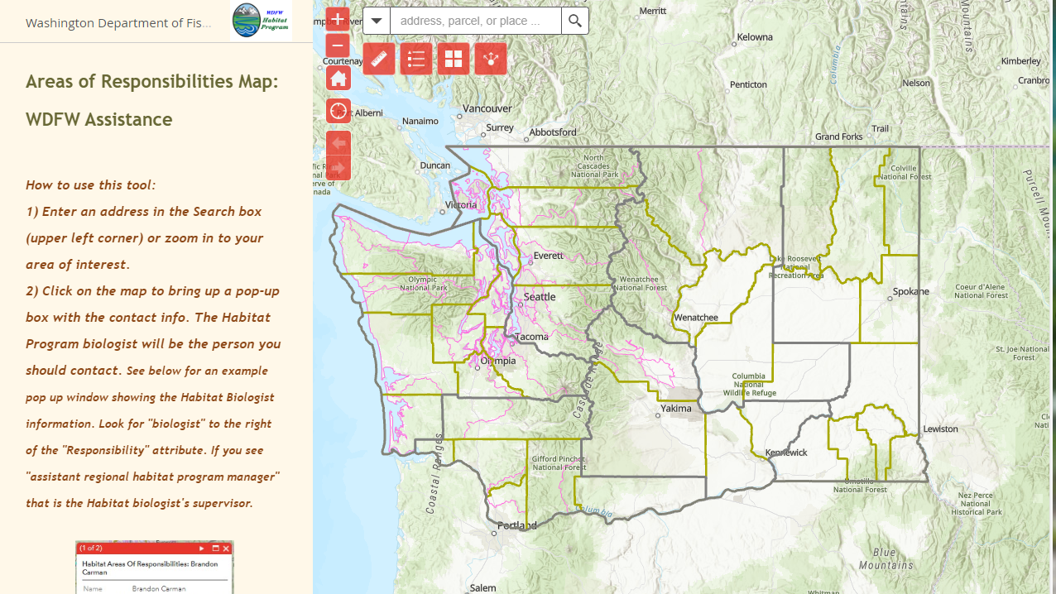


Who is your local area habitat bio?
Grant and Adams County: Eric Pentico
Methow Watershed: TBD
Okanogan Watershed: Elianna Rosenthal
Entiat, Chelan, and Douglas County: Nate Schmidt
South Chelan: TBD

